Slide 1
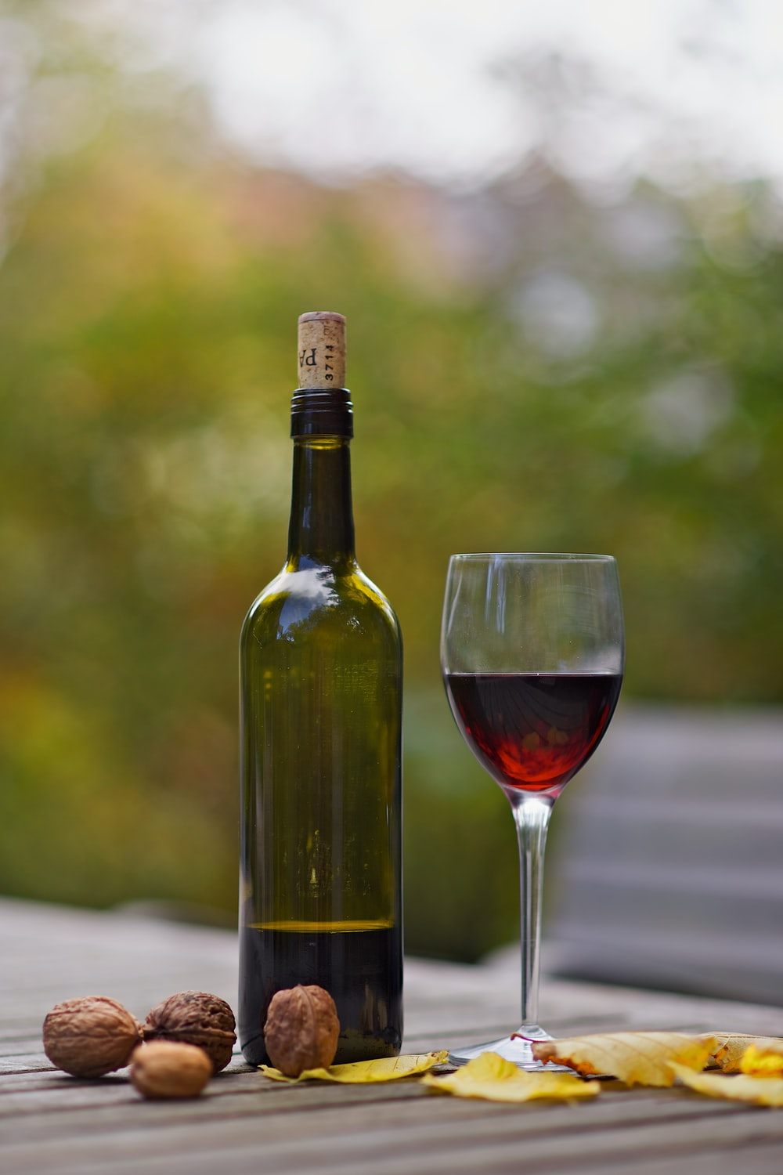
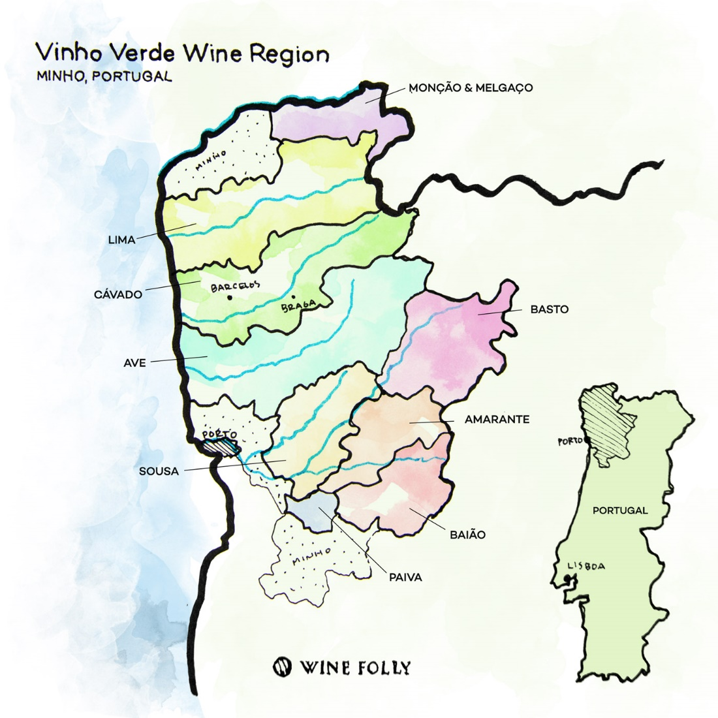
Why Jake as Head Vinter & Oenologist?
Your name | Teacher’s name | School

Slide 2
Vinho Verde Region Wine – Head Vinter
Key Qualification:
Proprietary process to consistently produce a high quality product
The process…
Discovery Matrix:
Identifies key relationships of core product characteristics (Qty and % Mix).
Performance Dispersion:
Identifies distribution of core product characteristics
Average Stack
Provides segmentation and scale of core product characteristics
Ranked Heat Map
Provides relationship trends
Results Mapping
Provides recipe targets of core product characteristics

Slide 3
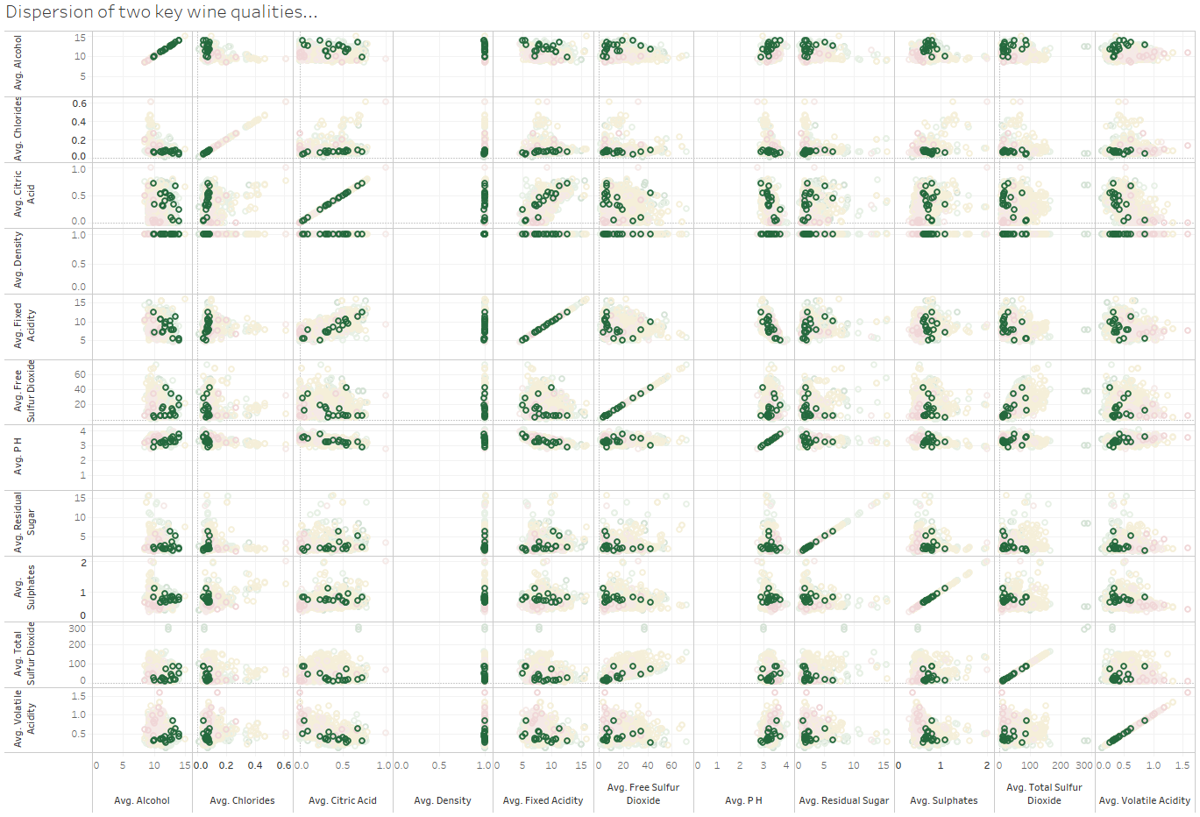
Discovery Matrix - Qty
Identify relevant relationships & correlations
Notes:
Summarize your research in three to five points.

Slide 4
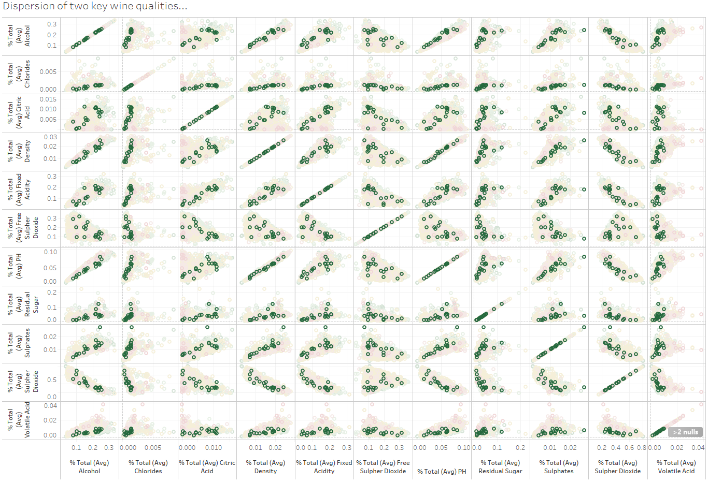
Discovery Matrix - % Mix
Notes:
Summarize your research in three to five points.

Slide 5
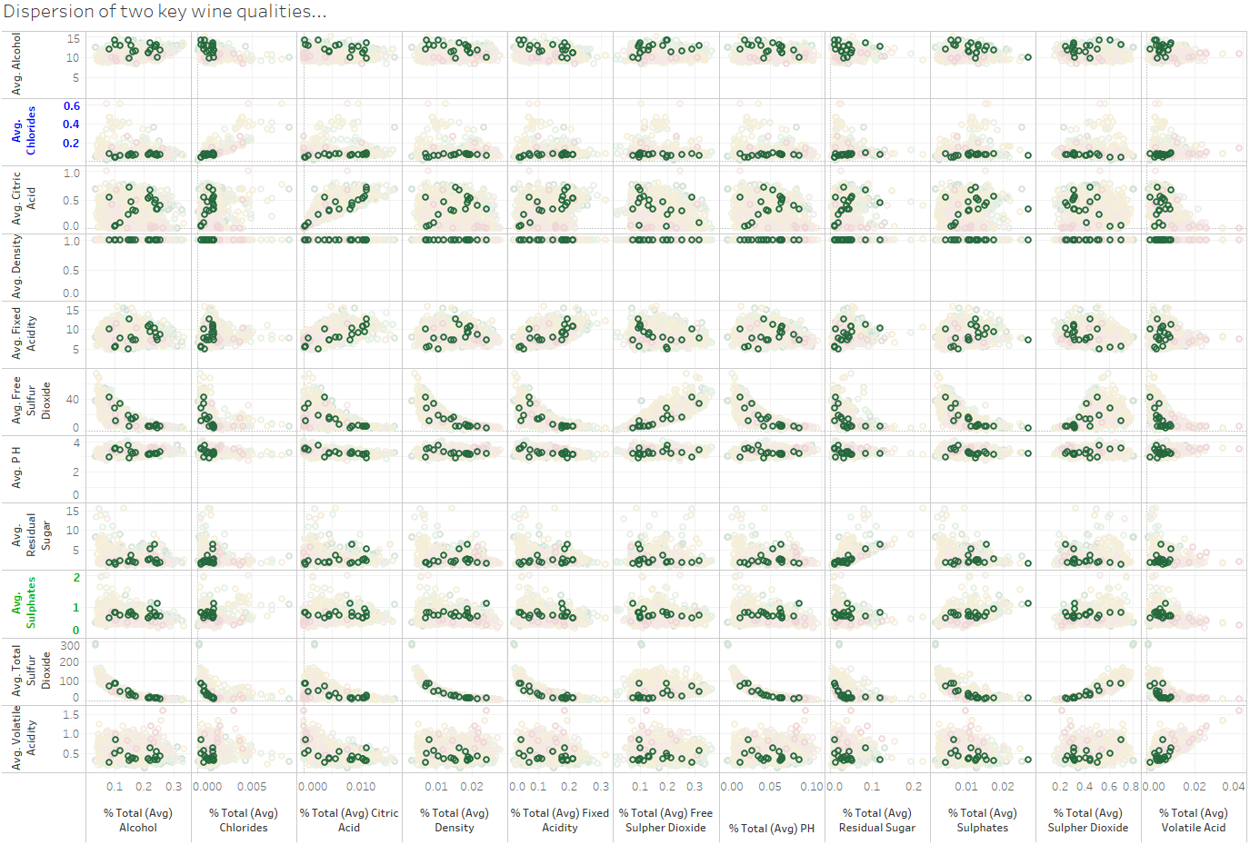
Research – Mix vs. Quantity
Notes:
Summarize your research in three to five points.

Slide 6
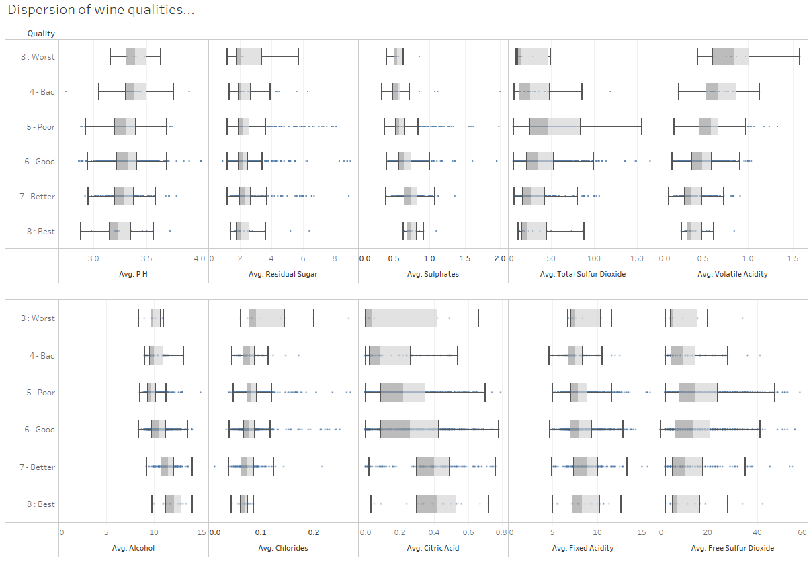
Performance Dispersion

Slide 7
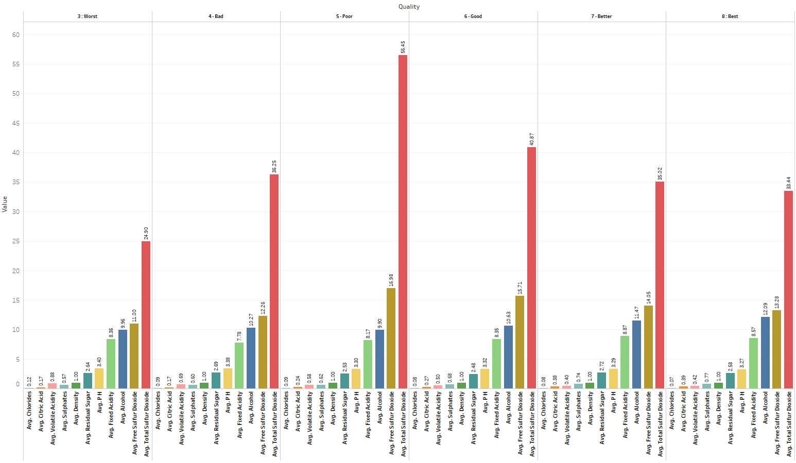
Average Stack

Slide 8
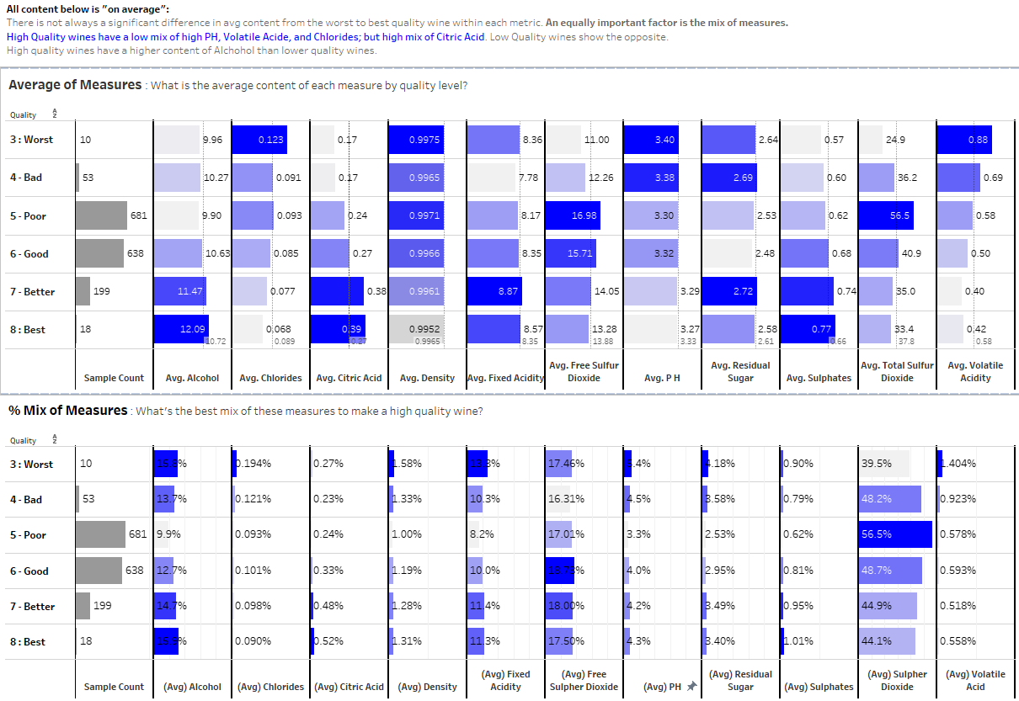
Ranked Heat Map

Slide 9
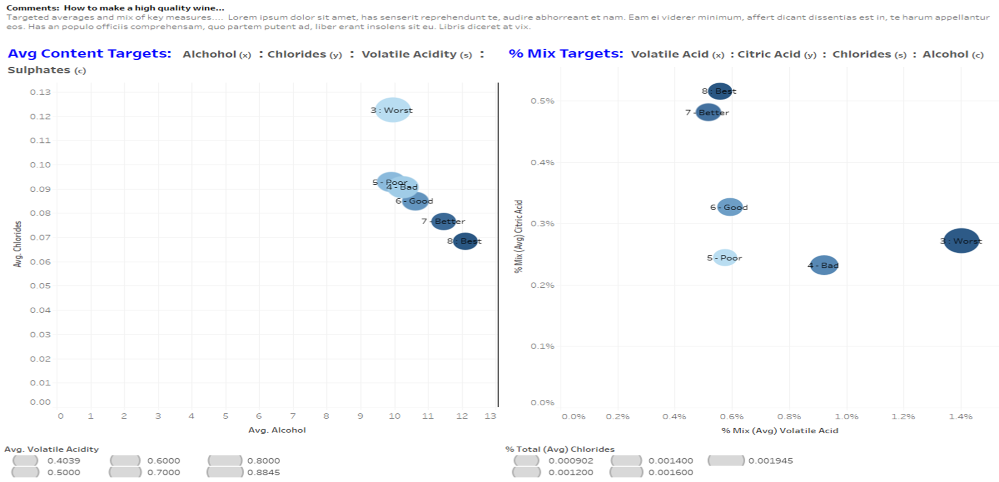
Results Mapping – What makes a high quality wine…

Slide 10
Conclusion
Brief summary of what you discovered based on results

Slide 11
Works Cited

